Slide 1
Perform observer duties
Identify correctly fish and marine species using established species identification processes based on anatomical features
Notes:
From the PIRFO training framework, explain anatomical and features – structure, body etc

Slide 2
BET & YFT Features
Fish parts and name
Size - length
Colour
Body shape
Marking/lines and dotted lines
Eyes – size if they can compare
Pectoral fins & second dorsal fin
Pectoral fins shape – sharp and blade
Tail V notch – size
Finlets – small and large
Second dorsal and anal fins, colour
Liver
Swimming bladder
Notes:
Explain each feature that will be covered in this ppt

Slide 3
Remember
Identifications should be based on a combination of features appropriate to the particular sample being examined – and not just a single feature. If doubt remains, the fish should be set aside and examined for internal characteristics
Notes:
Read out the text and emphasis on the combination of features

Slide 4
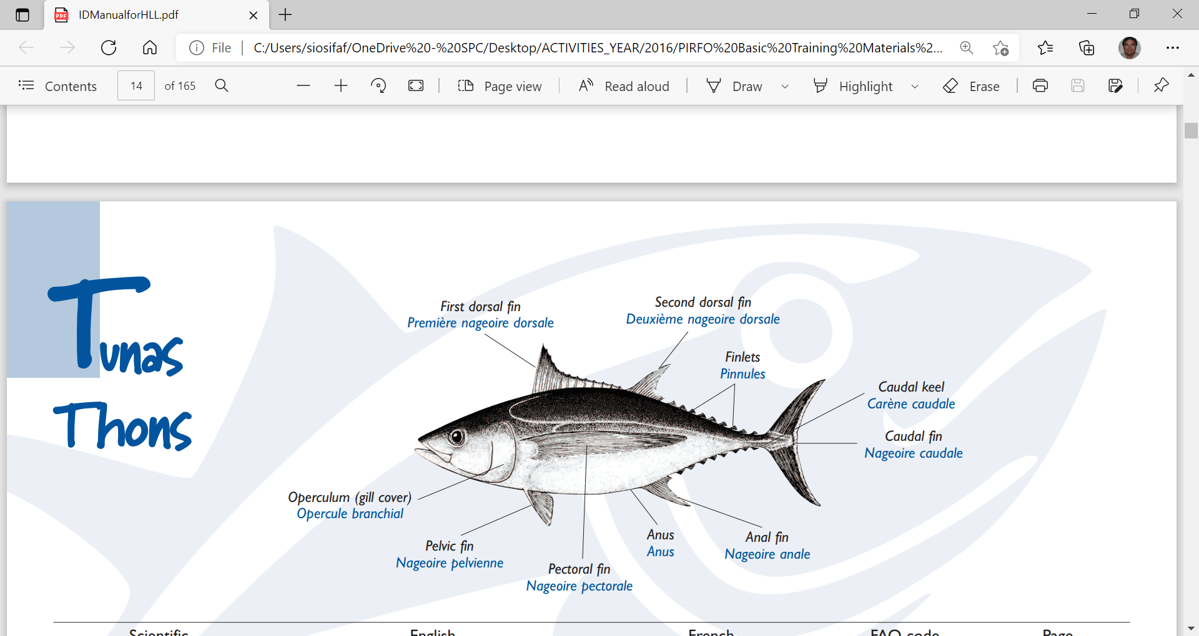
Notes:
Part of fish should be remembered and know very well in order to identify and pin point each feature

Slide 5
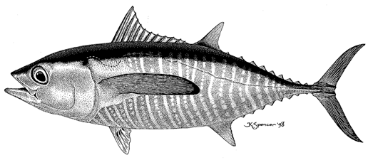
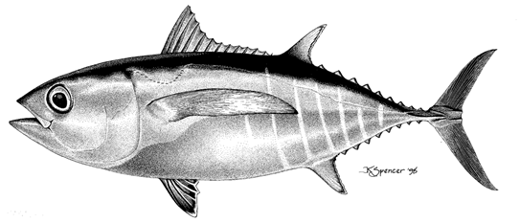
YFT and BET 30 - 45 cm

Slide 6
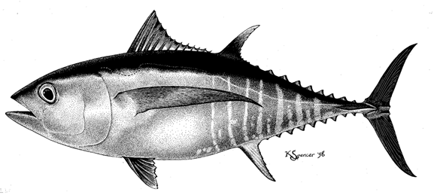
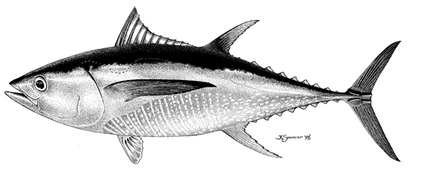
YFT and BET 46 -110 cm

Slide 7
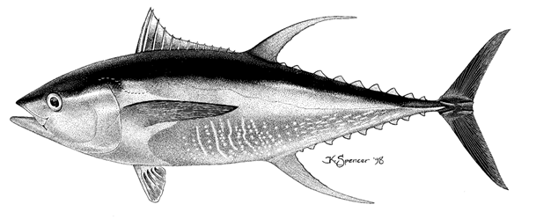
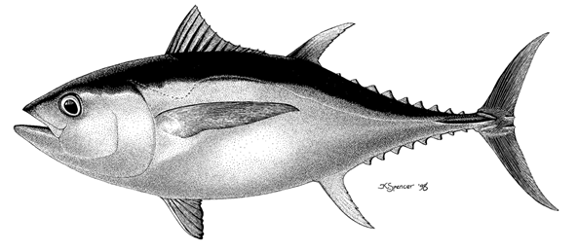
YFT > 110 cm

Slide 8
Notes:
Large YFT and size should be no problem with the ID

Slide 9
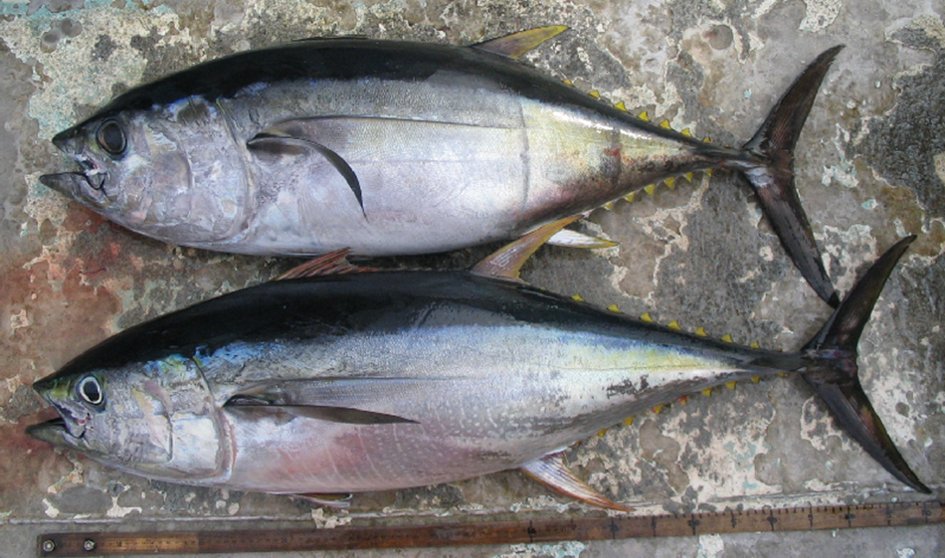
Notes:
Much easier if both species are put together side by side.

Slide 10
Notes:
Lines and dotted lines on YFT and BET

Slide 11
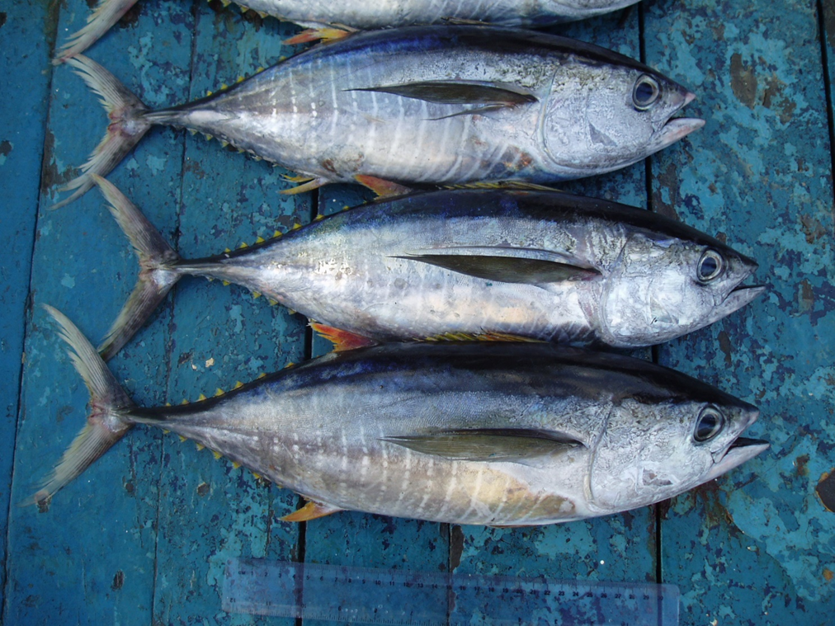
Notes:
YFT dotted lines

Slide 12
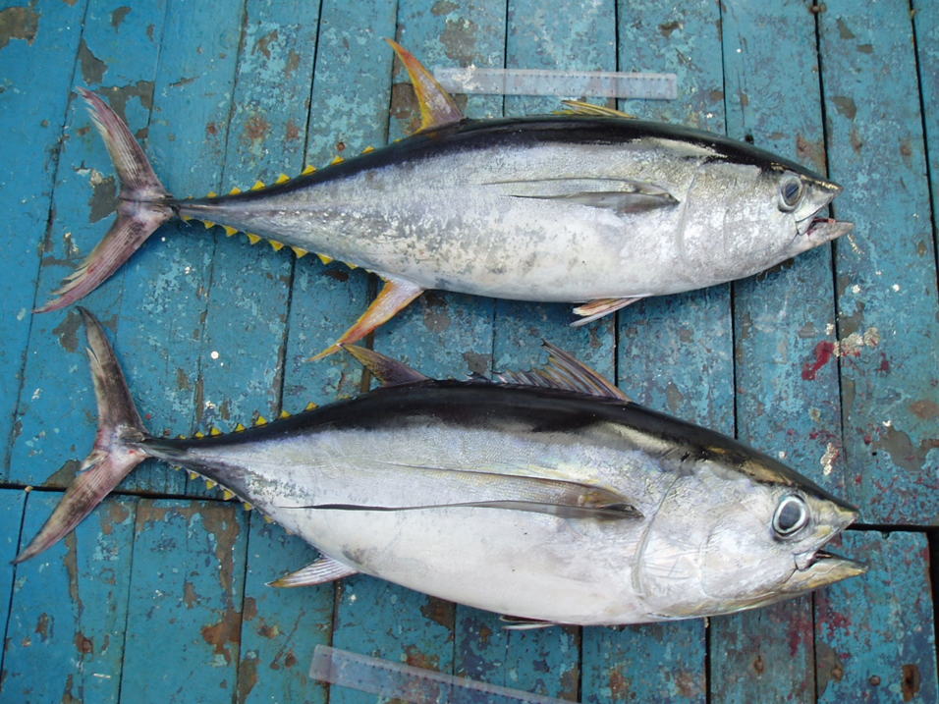
Notes:
Compare YFT and BET - second and anal fin, body shape, pectoral fin, size of the head, finlets

Slide 13
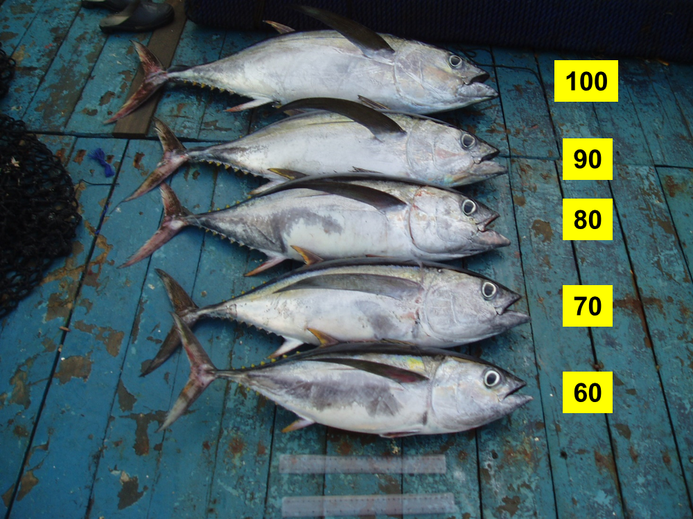
Notes:
BET at various length sizes, no marking, fresh, finlets, body shape - stocky and heavy, second and anal fin

Slide 14
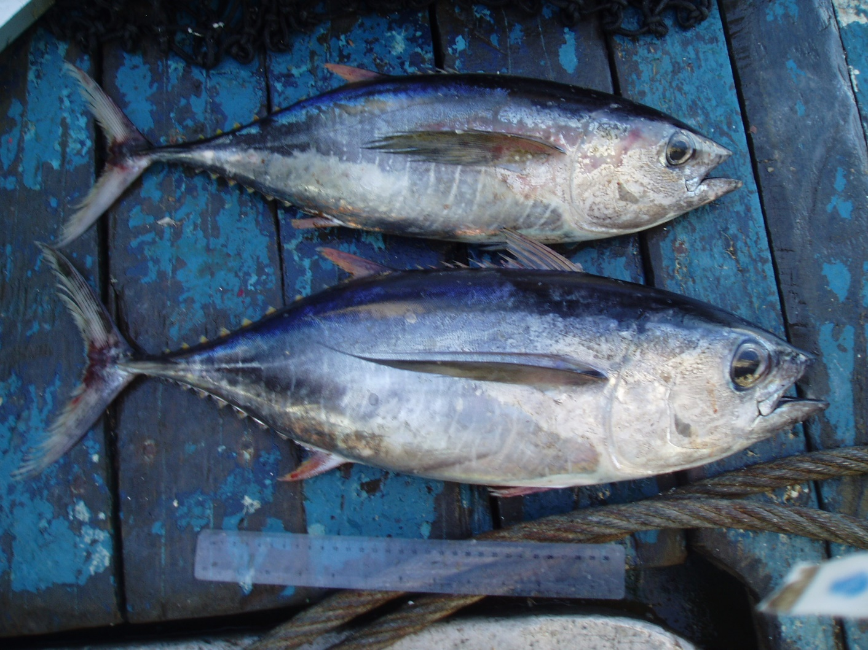
length 45 centimeters
YFT
BET
Notes:
YFT and BET – body shape, pectoral fins, marking – dotted lines and irregular lines, short 2nd and anal fin, eyes comparison

Slide 15
Length 45 cm
Notes:
Eye of the same size YFT and BET

Slide 16
YFT and BET Head size
Notes:
Head size of same size YFT and BET

Slide 17
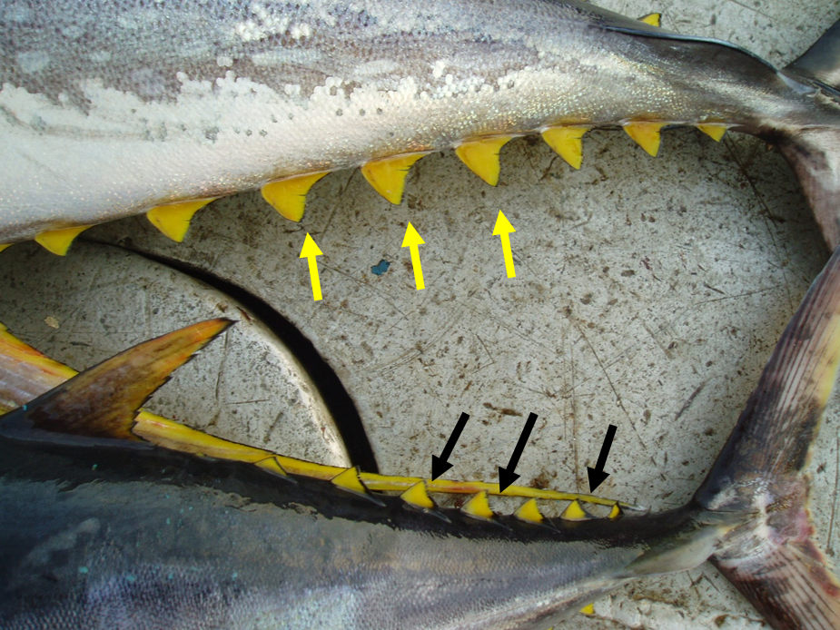
YFT and BET Finlets

Slide 18
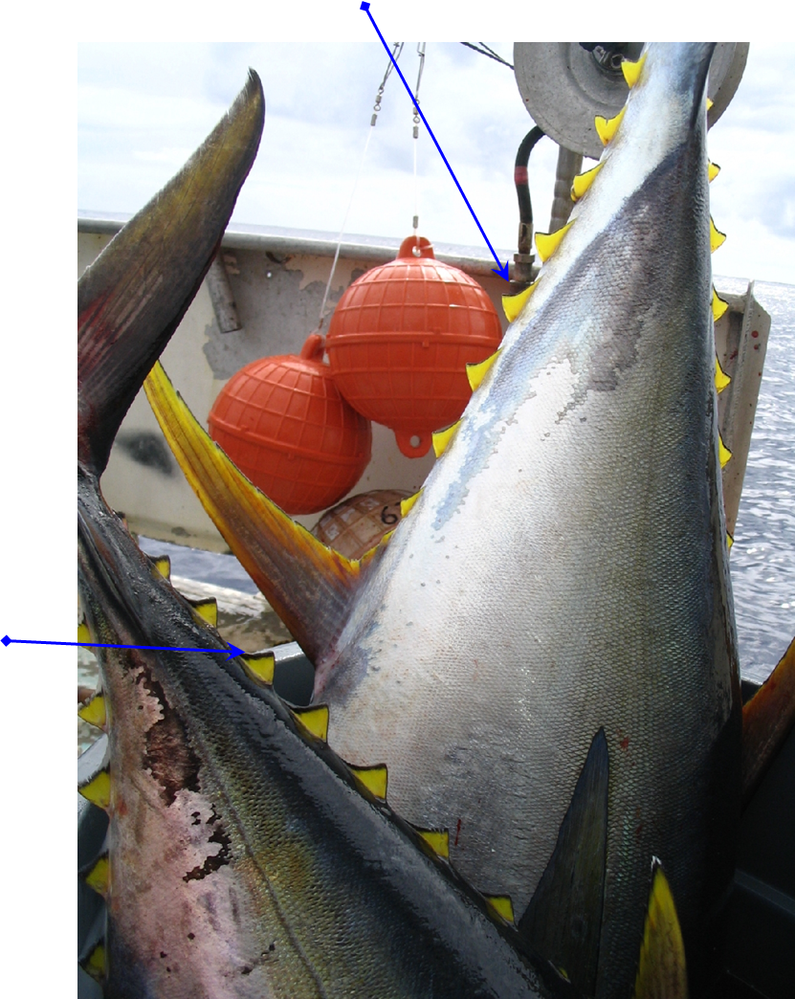
Notes:
YFT and BET finlets

Slide 19
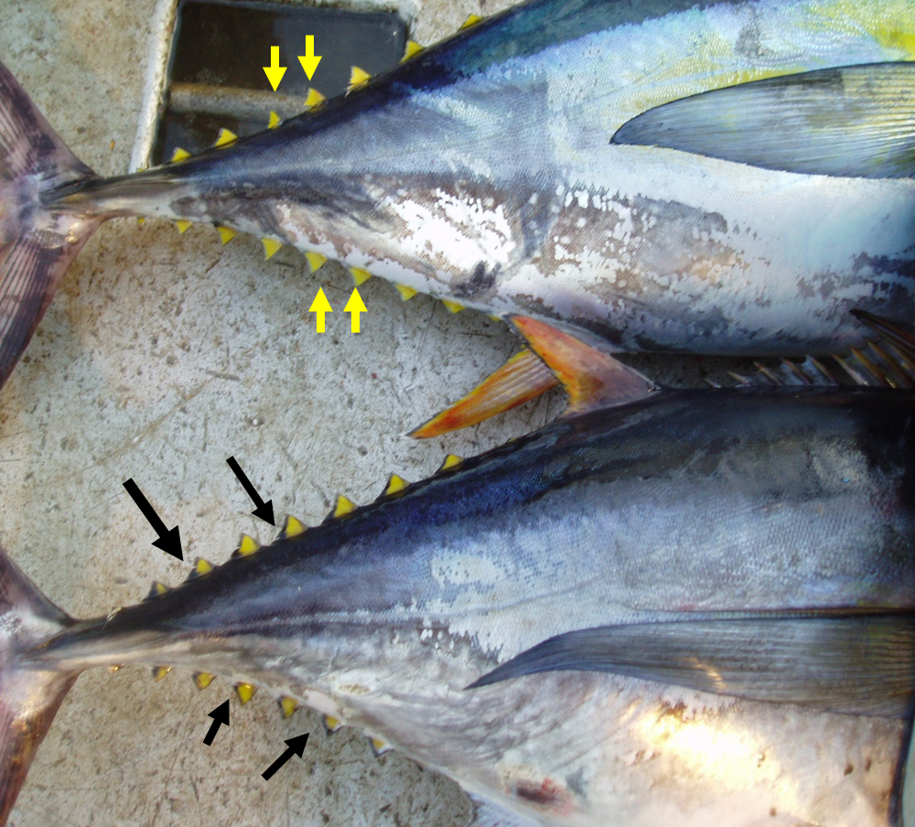
YFT and BET finlets

Slide 20
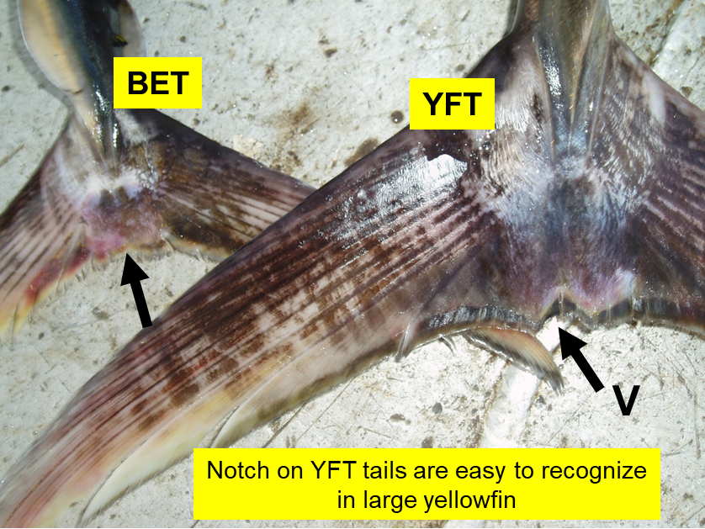

Slide 21
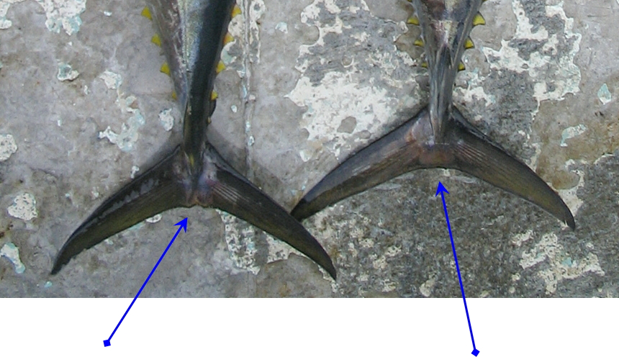

Slide 22
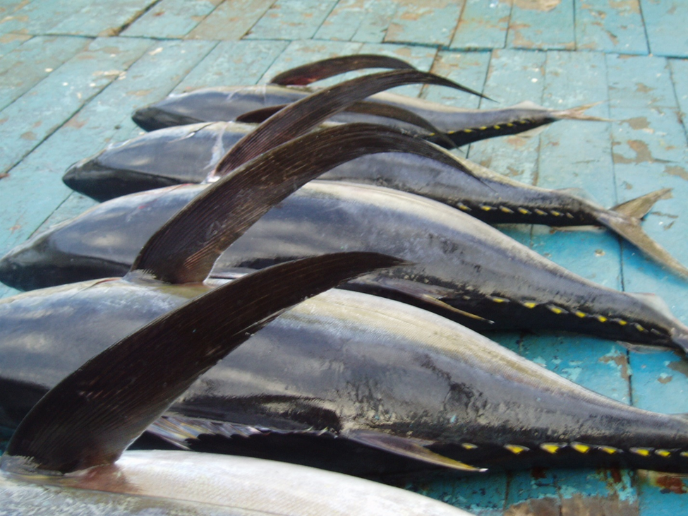
Pectoral fins BET 60-100 cm
Notes:
Pectoral fins pointed at the end, curved/bended toward the end part, sickle shape

Slide 23
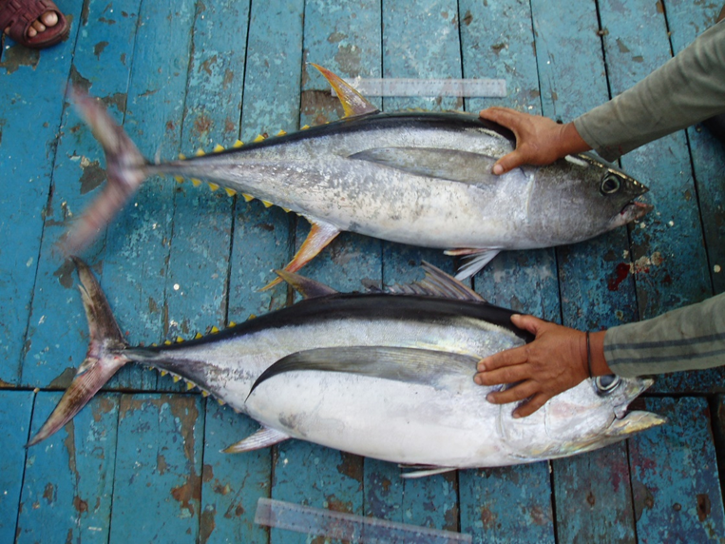
Pectoral fins YFT and BET 90
Notes:
YFT is blade shape while BET pointed and cured toward the end

Slide 24
Frozen
Notes:
Frozen is a different ID as some of the features disappeared and not easily to ID, again with this picture some of the features are really stand out. Always put ruler or something against the fish when taking photos

Slide 25
Frozen
Notes:
Sam photo

Slide 26
Frozen
Notes:
Small YFT with some of the marking still stand out.

Slide 27
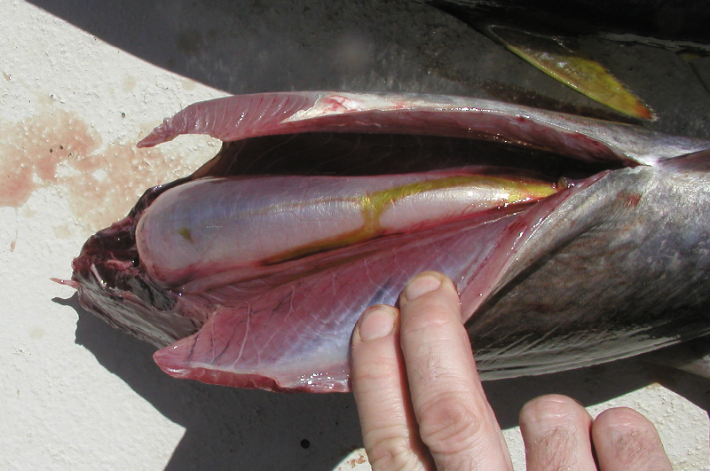
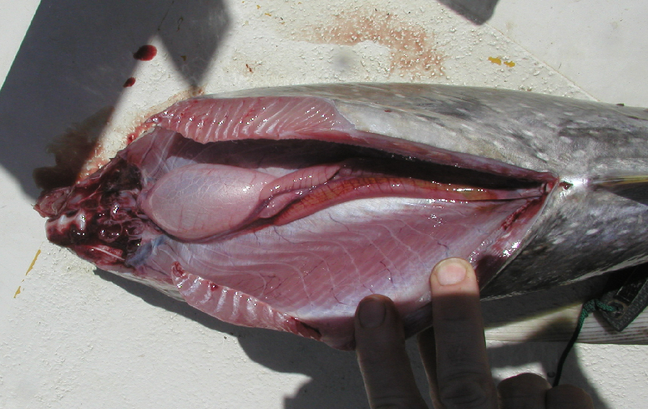
Internal Characteristics – ideal
Swim bladder morphology
Bigeye
occupies almost entire body cavity
large, conspicuous, often inflated
Yellowfin
only in anterior half of body cavity
inconspicuous, usually deflated or slightly inflated
Notes:
Explain the swimming bladder and the lacking in YFT, BET develop swimming bladder at early age

Slide 28
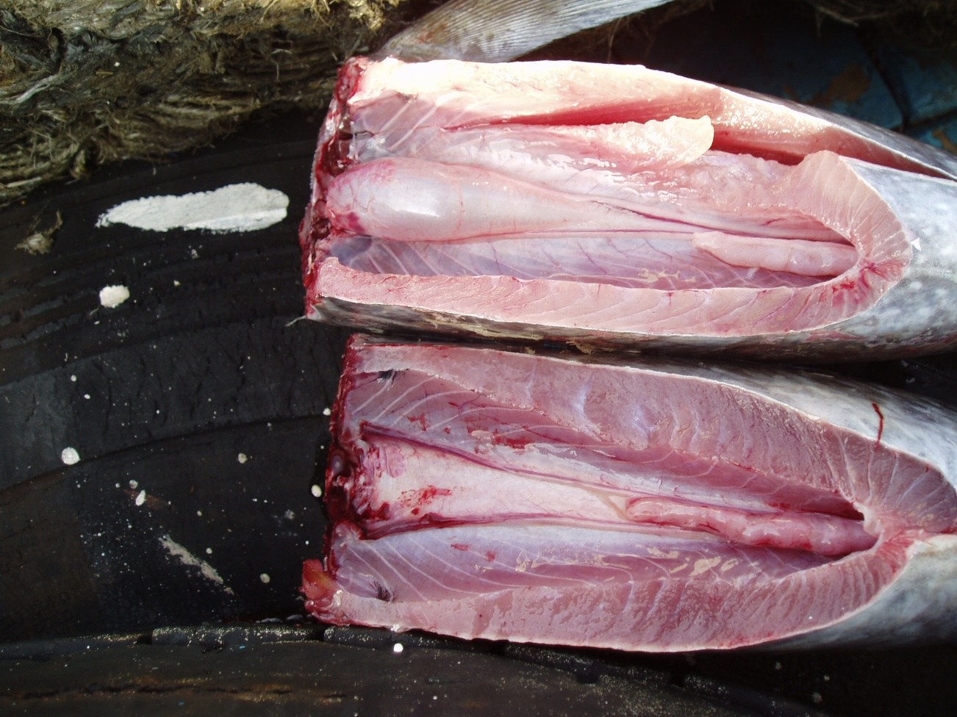
Swim bladder morphology
Yellowfin (43 cm)
Inflated swim bladder
YFT
BET
Bigeye (43 cm)
Deflated swim bladder

Slide 29
Liver

Slide 30
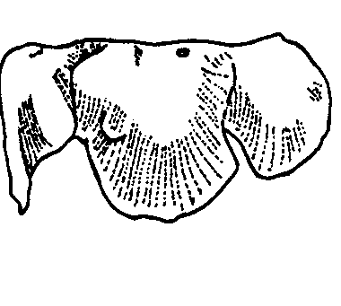
Liver

Slide 31
Remember
Identifications should be based on a combination of features appropriate to the particular sample being examined – and not just a single feature. If doubt remains, the fish should be set aside and examined for internal characteristics

Slide 32
Remember
Identifications should be based on a combination of features appropriate to the particular sample being examined – and not just a single feature. If doubt remains, the fish should be set aside and examined for internal characteristics

