Slide 1
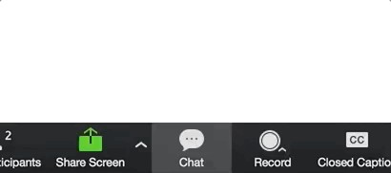
House rules
Greetings, Please rename yourself by Country
Keep your microphone muted and your video off at all times when you are not speaking.
Please ask questions or add comments in the Chat box
If you would like to speak, please click the Raise Hand icon
to do so, and the Chair will be notified

Slide 2
Meeting house rules
All Participants to use Headsets with inbuilt microphones when connecting remotely.
If you have low bandwidth or unstable connectivity, please turn your camera off when speaking.
Please speak slowly and clearly, always avoid background noise if you can do so
Please ensure you have the right training materials – ID, Guide infornt of you ready, to follow through with the training

