Slide 1
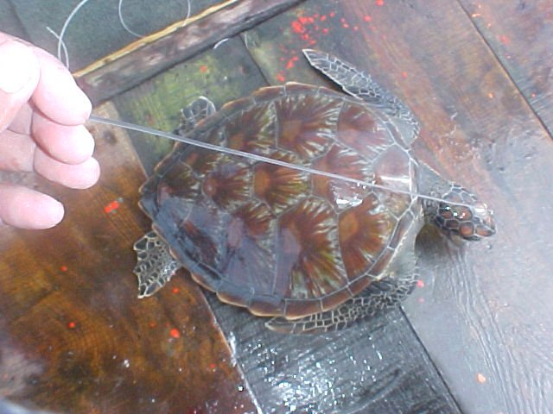
Turtle (green turtle)

Slide 2
Turtle - Carapace

Slide 3
Turtle - scutes
scutes
Lateral/Costal

Slide 4
Turtle- Scutes
Lateral

Slide 5
Turtle (green turtle)

Slide 6
Central
central

Slide 7
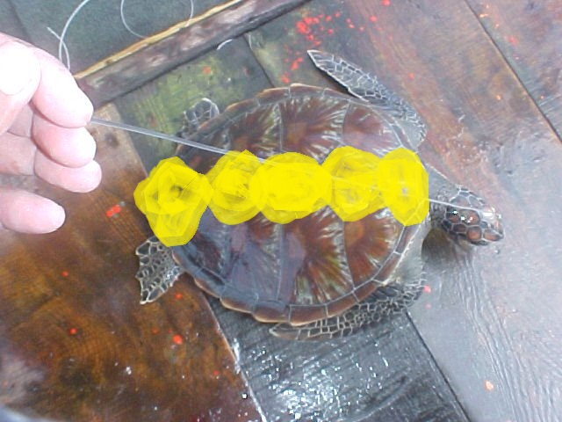
Central
central

